Slide 1
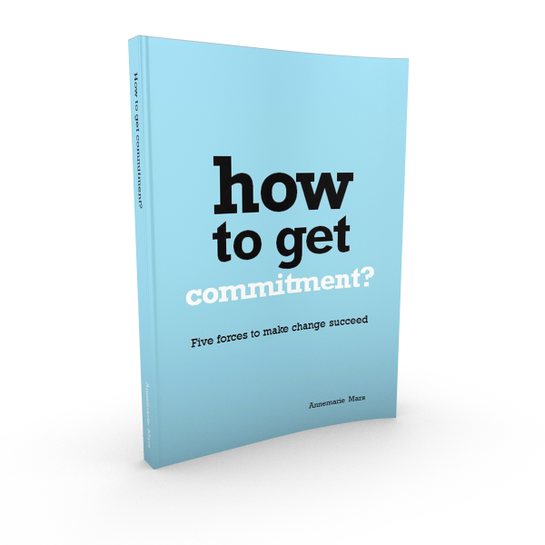
Basic images from:
‘How to get commitment’
For your own use in presentations and documents
Annemarie Mars
For a change
Please use with the proper credits

Slide 2
Commitment

+
=
Commitment
Situation
Behaviour
I understand it
I can do it
I feel responsible for my role in it
I estimate
the situation
I am doing it
I show accountibility for my behaviour
© Annemarie Mars, For a change

Slide 3
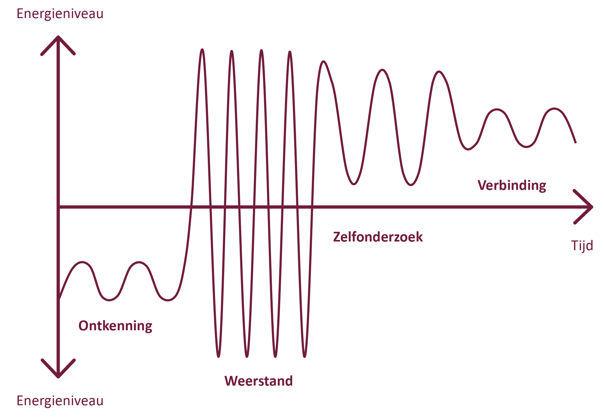
Reactions to change
Energy level
Aimed at
B
Commitment
Self Reflection
Aimed at
A
Denial
Resistance
Energy level
© Annemarie Mars, For a change

Slide 4
Five Forces to make change succeed
A
B
The situation
here and now
The situation
there and then
Planning
Urgency
Interaction
Ambition
Leadership
© Annemarie Mars, For a change

Slide 5
Urgency and ambition
A
B
The situation
here and now
The situation
there and then
Urgency
Ambition
Innovative powers
Pushing power
Pulling power
What will go wrong if you don’t change
What you want
to achieve
© Annemarie Mars, For a change

Slide 6
Change strategies
To have to
Commitment by appealing to loyalty and sense of duty
Directive leadership
Commitment by using information, analyses and argumentation
Expert
leadership
To let go
Commitment
through
non-intervention
Commitment by encouraging reflection
Coaching
leadership
To know
To learn and discover
Doelgroep
Commitment by honouring and
stimulating interests and preferences
Appreciative and inspiring leadership
To want
© Annemarie Mars, For a change

